Slide 1
New energy industry ESG performance evaluation and analysis — Subgroup B
Subgroup B member:
Wang Yihan, Lin Keni, Ji Xuanchi, Chen Shu.
Date: 2024.11.12

Slide 2
ESG performance evaluation methods
01
To effectively evaluate ESG performance using algorithmically structured data sets:
The report indicators are converted into labels, and these labels are classified into Economic, Social, and Gourvernance dimensions by weighting them.
The data of each dimension is integrated into the metrix of the overall ESG score to comprehensively evaluate the company's ESG.
Formulation of scoring system：
Based on SGX core ESG indicators, a set of scoring criteria has been developed:
The first three dimensions were Environmental Impact, Social Responsibility and Corporate Governance and the scores were subdivided on the basis of the three dimensions.
Define new energy industry-specific ESG metrics and weightings.
Standardization of indicator scores
Industry benchmarking and missing data handling：
Environmental Module Weighting: In the new energy sector, environmental indicators like carbon emissions, energy efficiency, and resource use are weighted higher. Social and governance aspects focus on employee safety, innovation, and transparent governance.
Standardized Metrics: Each category score is scaled from 0 to 100, transforming raw data into standardized metrics that facilitate easier performance evaluation and categorization.
Missing Data Handling: For categories with missing data, the function ensures no errors occur by assigning a score of if a category is empty.

Slide 3
ESG trends and patterns analysis
02
Insights on ESG performance trends and patterns.
Analysis of ESG scores for companies and sub-industries：
Wind and solar companies excel in environmental performance (carbon reduction, resource efficiency), while energy storage companies have challenges in waste management and supply chain transparency. There is still room for improvement in governance transparency and accountability mechanisms across the industry.
ESG strengths and weaknesses identification：
The new energy sector has significant advantages in environmental protection (carbon reduction, clean energy), but still faces challenges in governance transparency, supply chain compliance and waste management.
The relationship between ESG and financial indicators：
New energy companies with high ESG score usually have low volatility and low capital cost, showing strong market competitiveness; However, there are differences in performance on stock price correlation, and the financial impact varies by company and sub-sector.

Slide 4
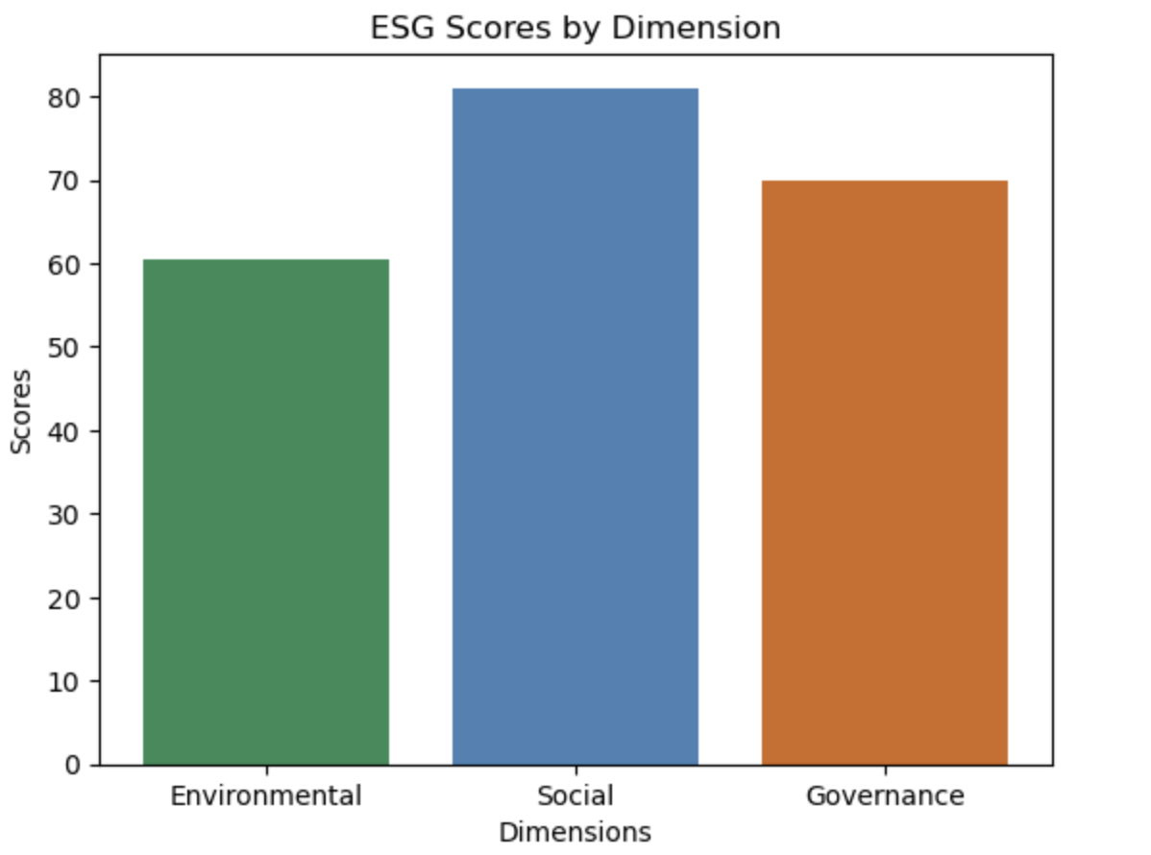
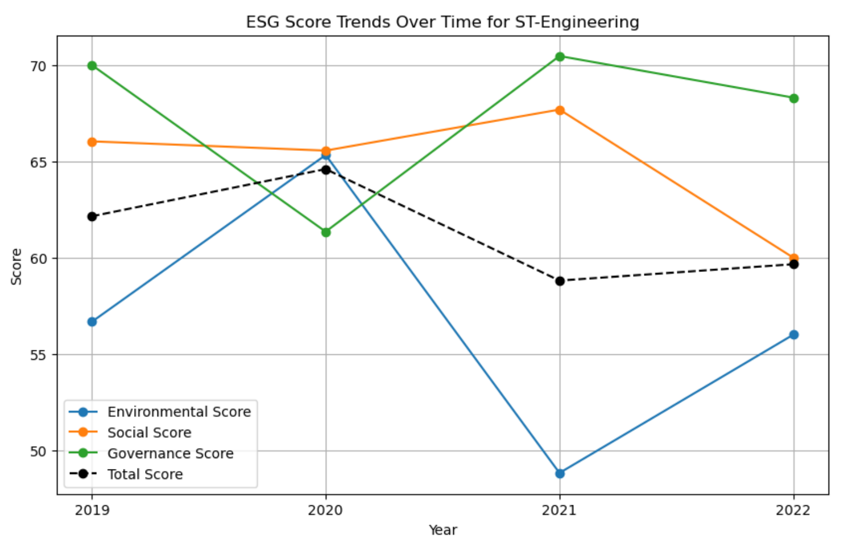
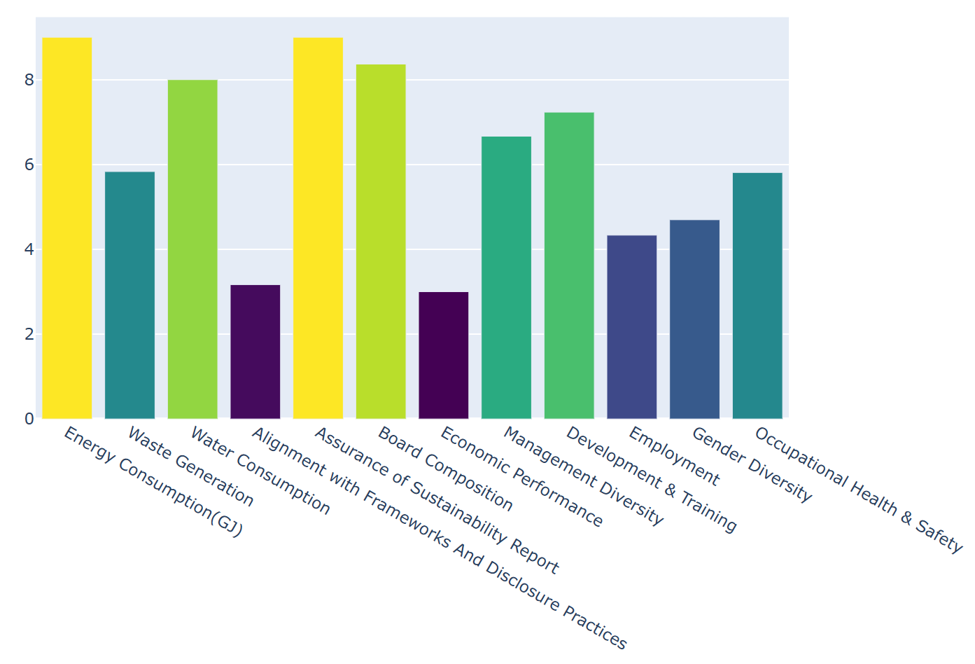
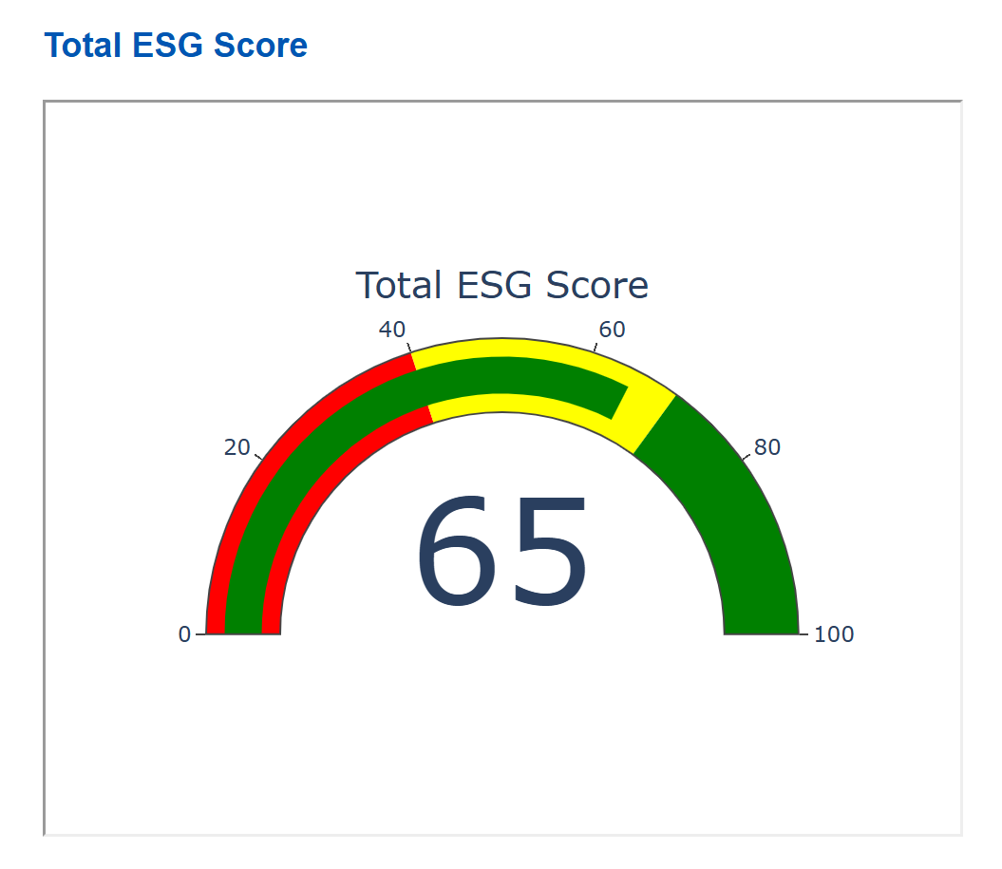
Visual presentation of ESG insights
03
Interactive Visualizations and Dashboards：
Built the front-end using React and included an interactive ESG dashboard on the front-end.
ESG scoring dashboard;
ESG score bar chart;
label score bar chart;
Overall ESG score line chart。
Stakeholder needs：
Provide specialized reporting templates based on the needs of investors, regulators and management, highlighting the ESG metrics of interest to each.
Automated summarization system：
Automatically analyze ESG reports to extract key content.
Generate an easy-to-understand summary of ESG performance and recommendations for improvement to enable stakeholders to quickly understand corporate sustainability.

Slide 5
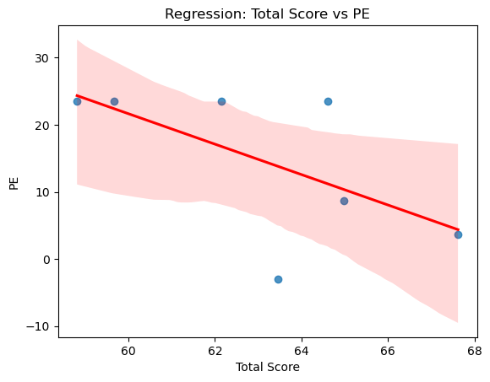
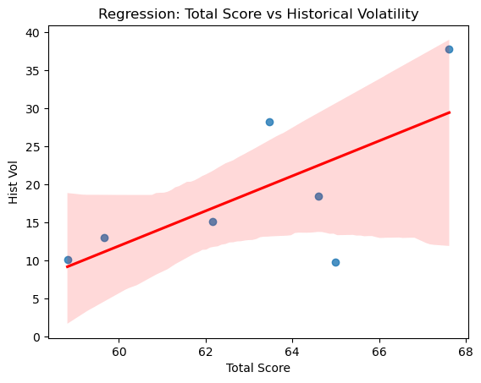
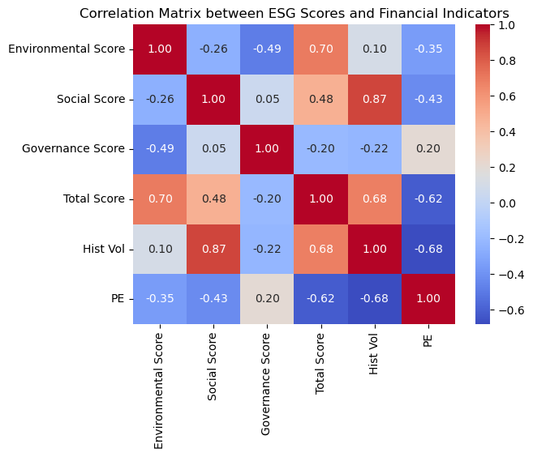
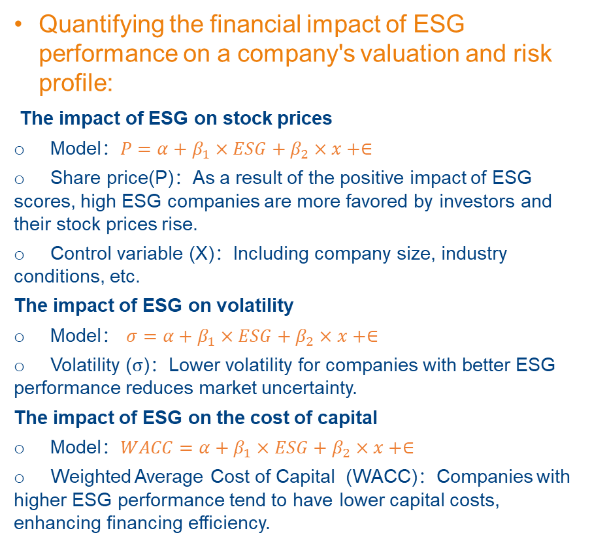
Quantifying ESG's impact on company valuation and risk
04
Quantifying the financial impact of ESG performance on a company's valuation and risk profile:
The impact of ESG on stock prices
Model：$P=α+β_{1}×ESG+β_{2}×x+∈$
Share price(P)：As a result of the positive impact of ESG scores, high ESG companies are more favored by investors and their stock prices rise.
Control variable (X)：Including company size, industry conditions, etc.
The impact of ESG on volatility
Model： $σ=α+β_{1}×ESG+β_{2}×x+∈$
Volatility ($σ$)：Lower volatility for companies with better ESG performance reduces market uncertainty.
The impact of ESG on the cost of capital
Model：$WACC=α+β_{1}×ESG+β_{2}×x+∈$
Weighted Average Cost of Capital (WACC)：Companies with higher ESG performance tend to have lower capital costs, enhancing financing efficiency.
Correlation Heat maps show the correlation between ESG scores and financial metrics

Slide 6
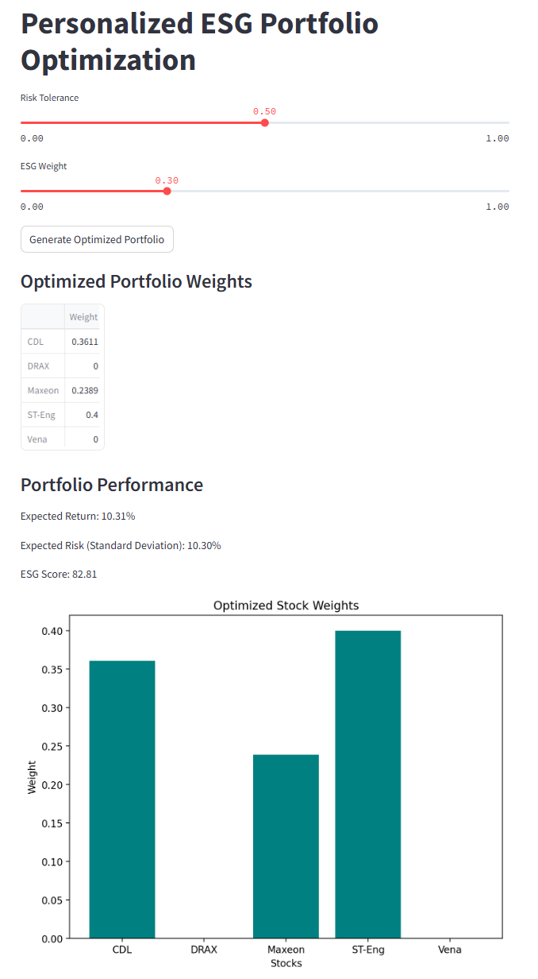
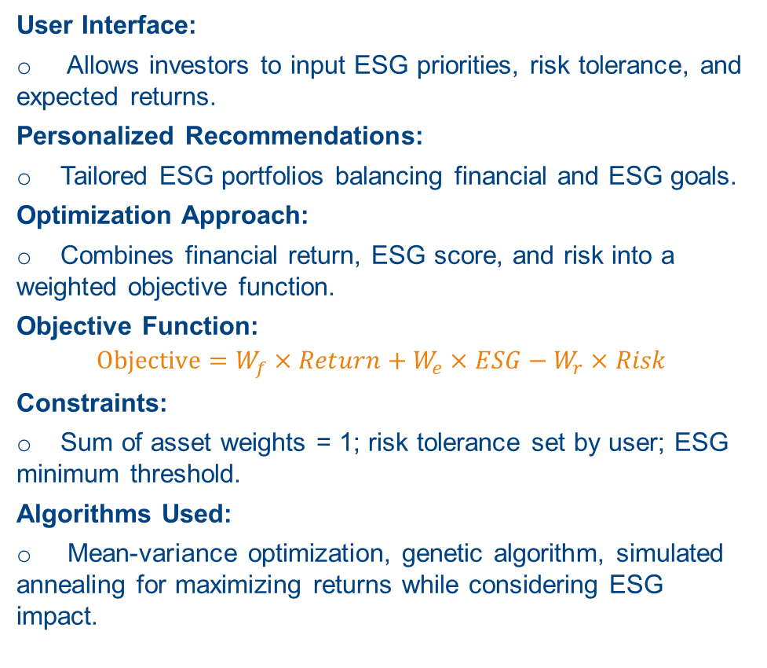
Personalized ESG Investment Strategies
05
User Interface:
Allows investors to input ESG priorities, risk tolerance, and expected returns.
Personalized Recommendations:
Tailored ESG portfolios balancing financial and ESG goals.
Optimization Approach:
Combines financial return, ESG score, and risk into a weighted objective function.
Objective Function:
$$Objective=W_{f}×Return+W_{e}×ESG−W_{r}×Risk$$
Constraints:
Sum of asset weights = 1; risk tolerance set by user; ESG minimum threshold.
Algorithms Used:
Mean-variance optimization, genetic algorithm, simulated annealing for maximizing returns while considering ESG impact.

Slide 7
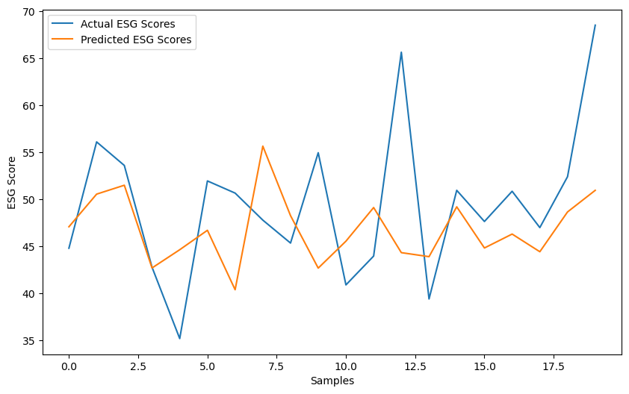
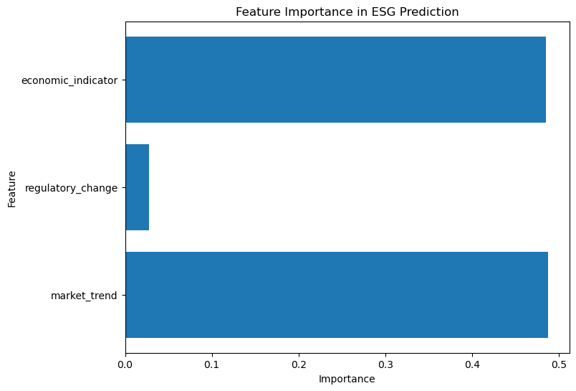
Predictive model to forecast future ESG performance
06
1. Project Background and Objective
Objective: To develop a machine learning predictive model that forecasts future ESG (Environmental, Social, and Governance) performance based on historical data and external factors.
2. Data Characteristics
Historical ESG Scores: Past ESG scores are used to train the model, allowing it to understand the company’s ESG performance over different time periods.
External Factors:
Market Trends: Reflects changes in macroeconomic market conditions.
Regulatory Changes: Tracks variations in ESG-related regulations (such as the implementation of new policies).
Economic Indicators: Represents the overall economic environment to capture factors potentially impacting company performance.
3. Model Selection
Reason for Choice: We selected the Random Forest Regressor because it performs well in complex, nonlinear relationships and multi-feature scenarios, providing robust predictions.
4. Model Development Process
Data Preprocessing, Model Training,Evaluation and Validation

Slide 8
Integrated ESG Data Extraction and Performance Analysis Strategies
07
Goal:
Improve data extraction accuracy and comprehensiveness of ESG analysis。
Extraction and Evaluation:
Automatically extract key information using NLP models to ensure data consistency. Build scoring systems based on SGX metrics for industry benchmarking and trend analysis.
Customized reports:
Generate on-demand reports and interactive dashboards exclusive to investors, regulators, and company executives.
Future：
Introduce predictive analytics to forecast future ESG performance trends through machine learning, while continuously optimizing the algorithm to adapt to changing ESG reporting standards and market needs. Quantify the financial impact of ESG performance on company valuation and risk profile.

Slide 9
THANK YOU

